Slide 2

What Is Augmented Reality?
AR stands for augmented reality. Augmented reality is an interactive experience that blends the real-world environment with the digital world. Many popular apps use augmented reality to add digital effects to what you can see on your camera.
Have you ever added a pair of dog ears to your selfie, or used a filter to touch up your makeup? Those filters rely on AR.
You also might be familiar with Pokemon Go, the virtual creature-catching craze that swept the nation - the game uses augmented reality to show creatures on your phone screen so that you can walk around and interact with the Pokemon on your screen as if they were there in real life. Interior design software is another area of technology that has increasingly begun to use AR to allow you to preview how different furniture arrangements or paint colours would look in a room.
But how can augmented reality be used in the classroom?

Slide 3
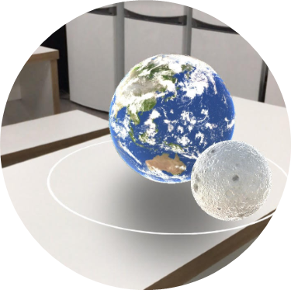
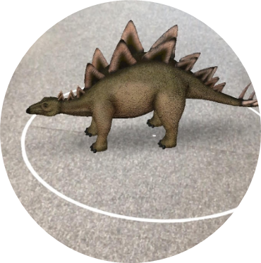
How Can Augmented Reality Be Used in the Classroom?
Augmented reality brings lessons to life! It can be used to digitally show children art, animals and other culturally significant objects that you might find at distant locations. Through using the augmented reality in Google Expeditions, you could meet some dinosaurs from the Jurassic period, take a closer look at Van Gogh’s paintings or explore the solar system.

Slide 4
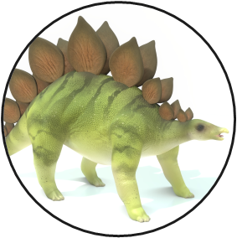
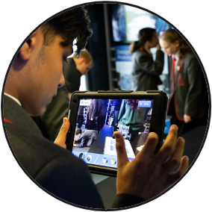

How Can Augmented Reality Be Used in the Classroom?
Twinkl also provides educational augmented reality content that you can use in the classroom. Children can build towers and bridges in ARchitect, learn to code in Little Red Coding Club, read books supported with AR or even build a virtual planetary exploration robot (like a Mars rover) in Twinkl Robotics.
You could use AR as an exciting introduction to a topic; to support a tricky concept; as a practical and interactive way of teaching a subject; or as a way to bring objects into the classroom that children would never normally have the opportunity to see.

Slide 5
The Benefits of Using AR Technology in the Classroom
Using augmented reality in the classroom can inspire a sense of awe and wonder, creating exciting experiences that will help children to retain what they have learnt.
AR gives children access to experiences that support their understanding of a topic. For example, it is much easier to understand how planets orbit around the Sun when you are standing in the centre of a moving model of the solar system!
AR offers more opportunities to include interactive and practical activities in your lessons that children will be enthusiastic to try.
You can decide how to use augmented reality in your lessons in a way that works best for you and your class.

Slide 6
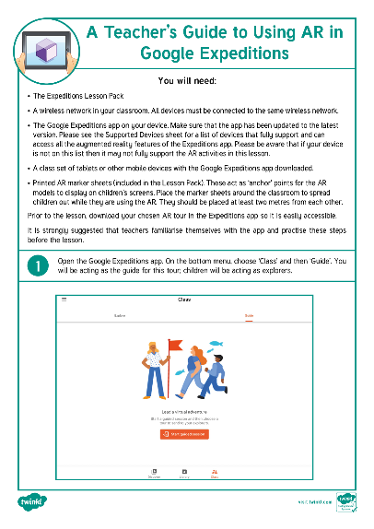
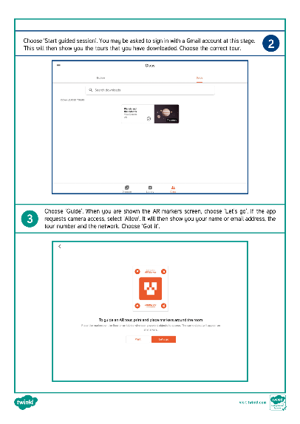
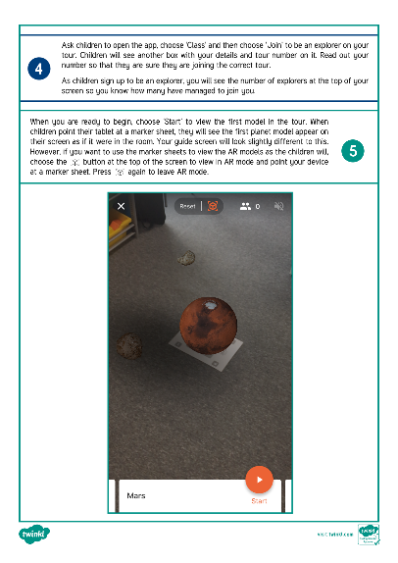
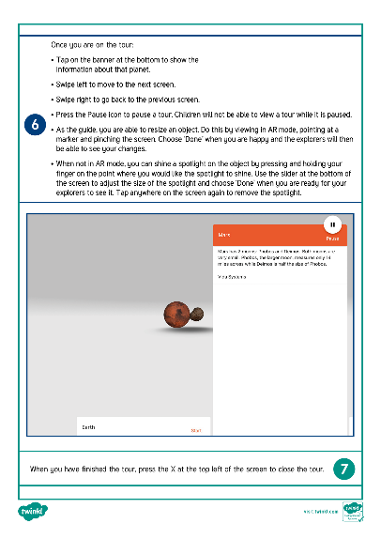
Top Tips
Here are some top tips for using AR technology in your lesson:
Before the lesson, give yourself time to familiarise yourself with the technology and how to use it. If you choose to use the AR technology available in Google Expeditions, Twinkl has created a step-by-step guide on how to use this app in the classroom, which has also been included in each Google Expeditions lesson pack.

Slide 7
Top Tips
Give yourself time before the lesson to set up the technology and any other resources. This may involve making sure that the devices you will be using are adequately charged, have the appropriate apps installed and are all connected to the same wireless network.
Set ground rules with children on how they will use the technology.
Be reflective. Any new teaching method can experience ‘teething problems’ at first. Try to pinpoint any issues that arise – are children finding the technology difficult to use? Are they getting too distracted by the technology? Once you have spotted the problem, you can put strategies in place to support children and make the most of the technology.

